Slide 1

Introduction to
Economic Growth

Slide 2
World Distribution of Real GDP
先看几个图
然后总结几个特点：
  整体来说，全球经济在增长（最低值和最高值都在提升）
  全球处于贫困区间的人口在减少
  一些穷国永远穷
  发展中国家占大多数，发达国家依旧少数（长尾）
  发展中国家的追赶效应明显

Slide 3
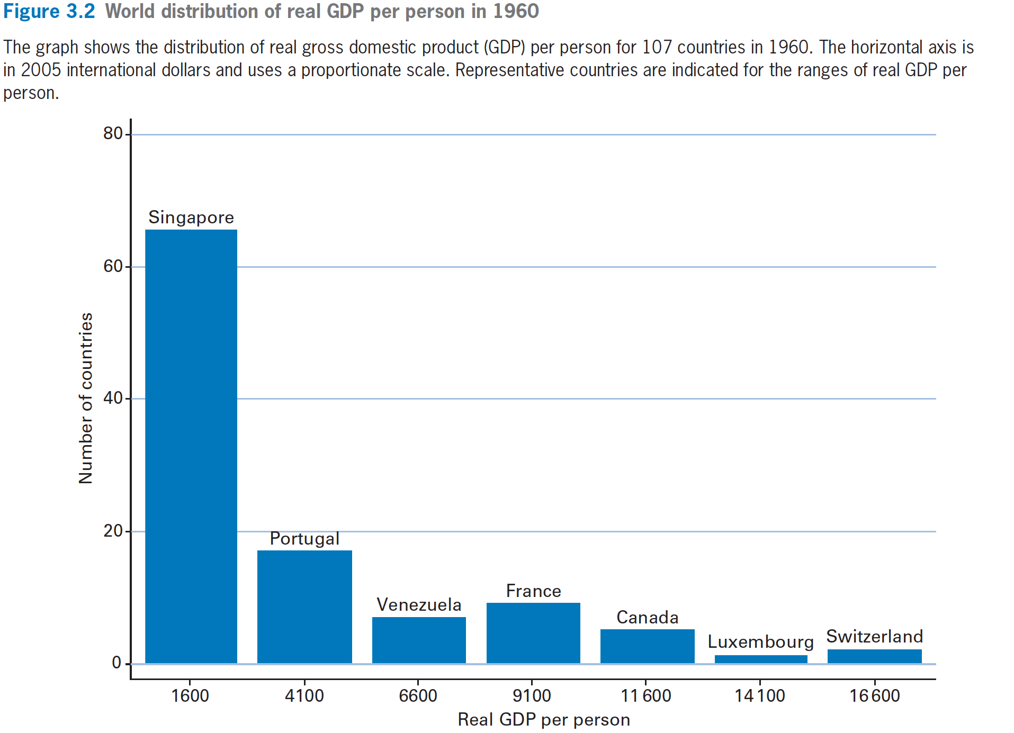

Slide 4
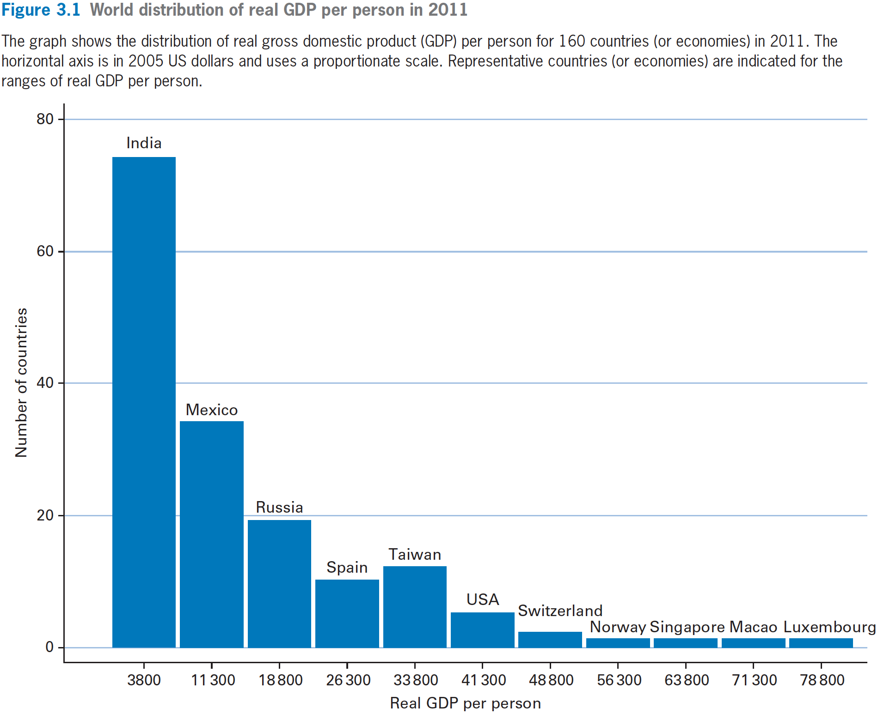

Slide 5
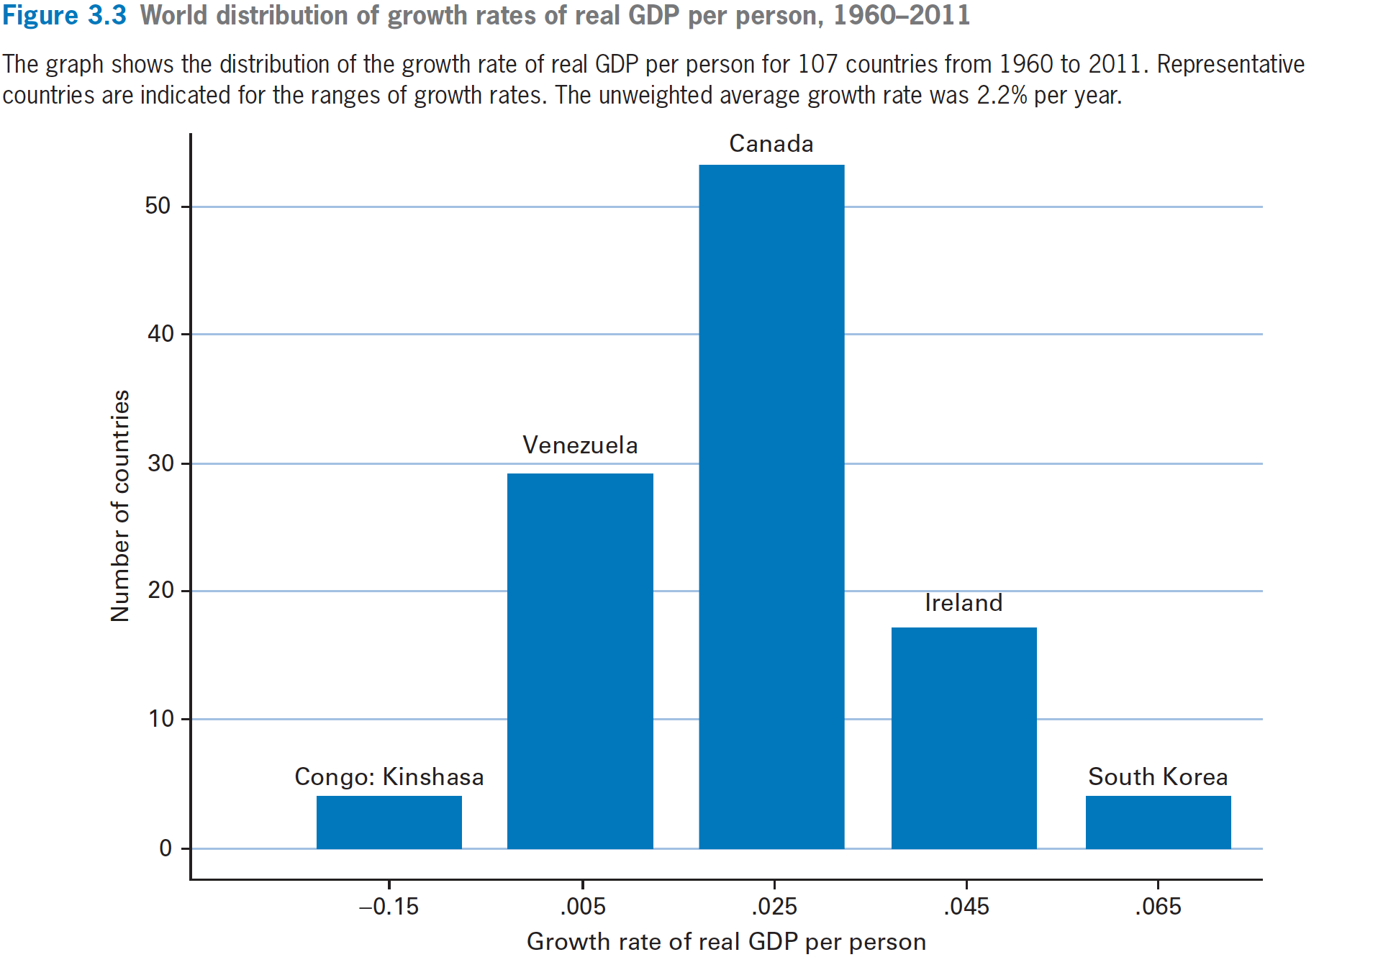

Slide 6
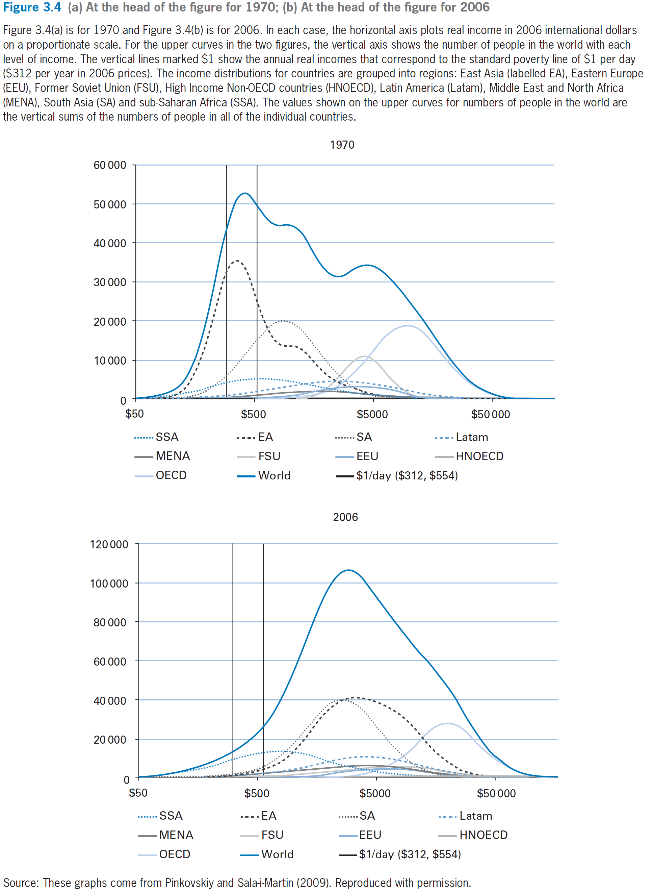

Slide 8
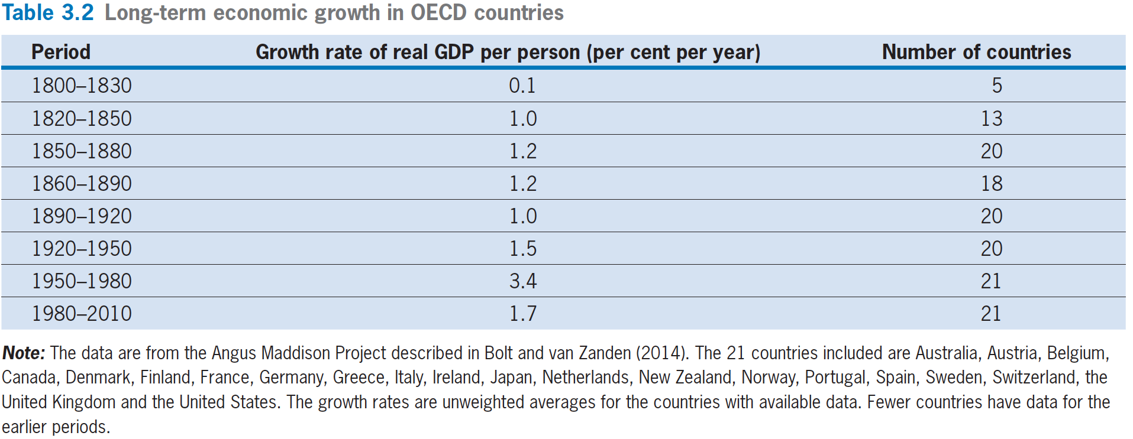
Long Term Economic Growth in
OECD Countries

Slide 9
Productivity Slowdown
OECD国家： The decline in the growth rate of real GDP per person from 3.4% per year for 1950–1980 to 1.7% per year for 1980–2010 is sometimes called the Productivity Slowdown （生产力下降）

Slide 10

Growth Questions
What factors caused some countries to grow fast and others to grow slow over periods, such as 1960 to 2011?
In particular, why did the East Asian countries do so much better than the sub-Saharan African countries（SSA：撒哈拉以南非洲）?
How did countries such as the United States and other OECD members sustain growth rates of real GDP per person of around 2% per year for a century or more?
What can policymakers do to increase growth rates of real GDP per person?

Slide 11
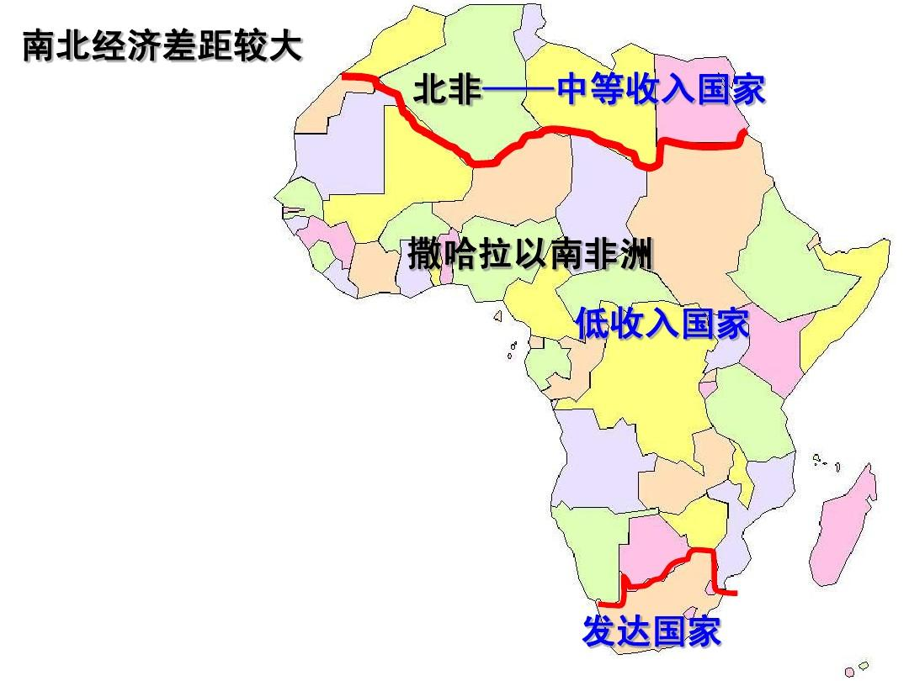
非洲地图

Slide 12
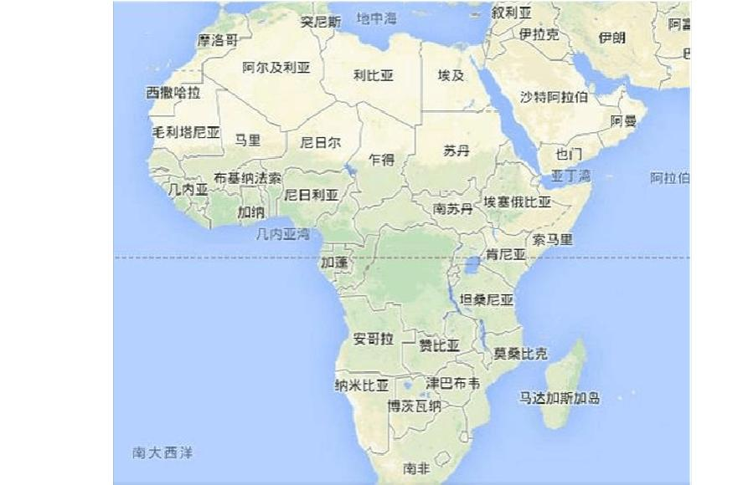
非洲地图

Slide 13
Production Function
Y = A· F(K, L)
  A ➔ Technology Level
  K ➔ Capital Stock – machines and buildings used by business and factories
  L ➔ Labor Force – number of workers

Slide 14
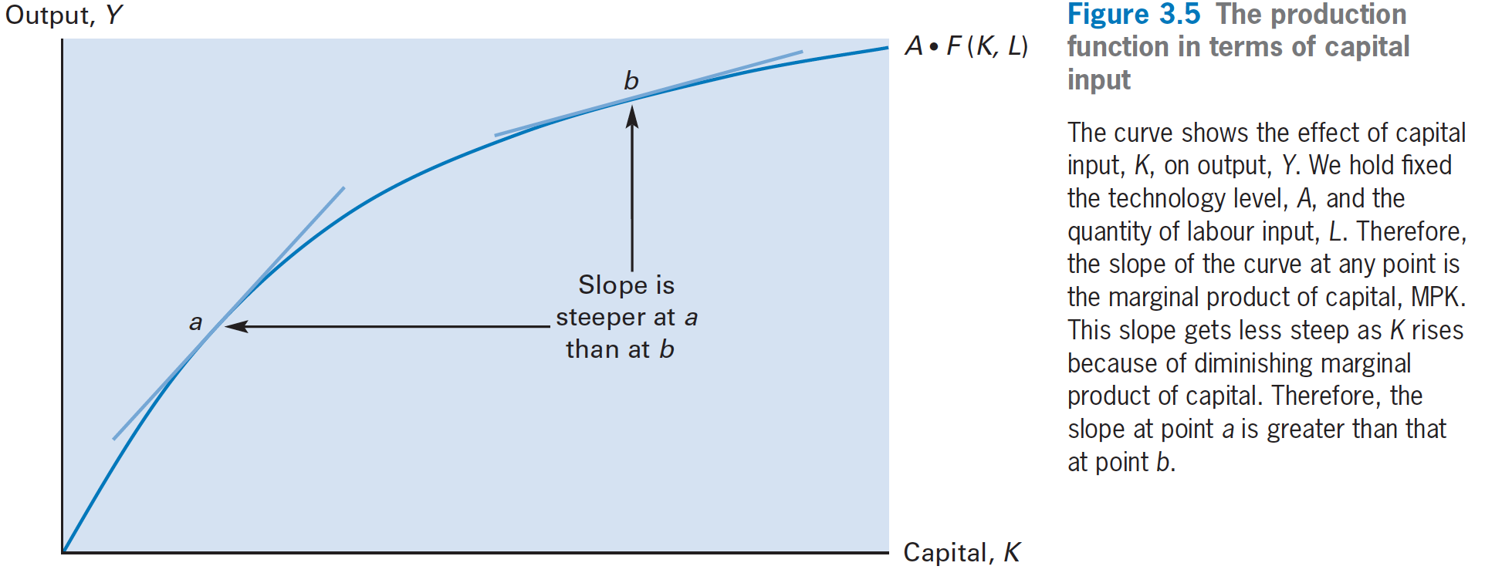
Production Function

Slide 15
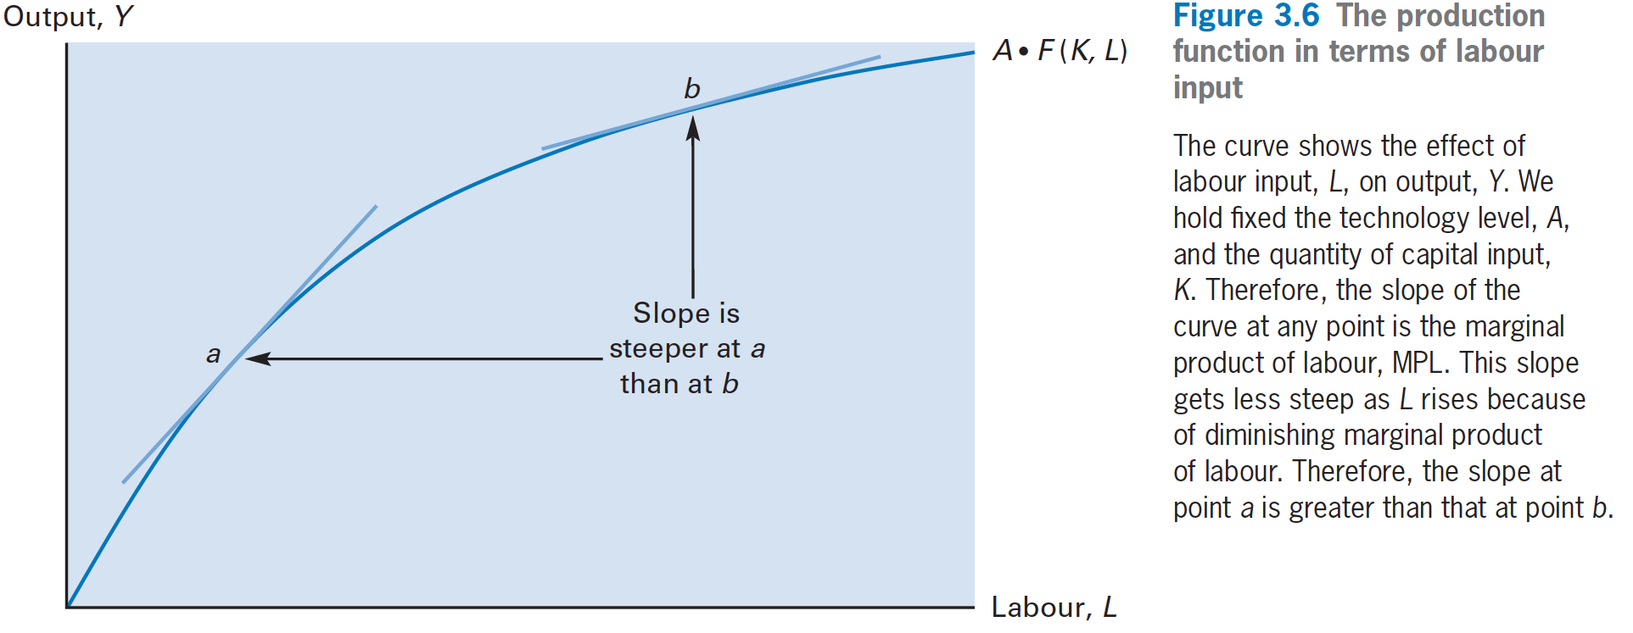
Production Function

Slide 16
Production Function
MPL – Marginal Product of Labour
  Diminishing Marginal Product of labour
MPK – Marginal Product of Capital
  Diminishing Marginal Product of Capital

Slide 17
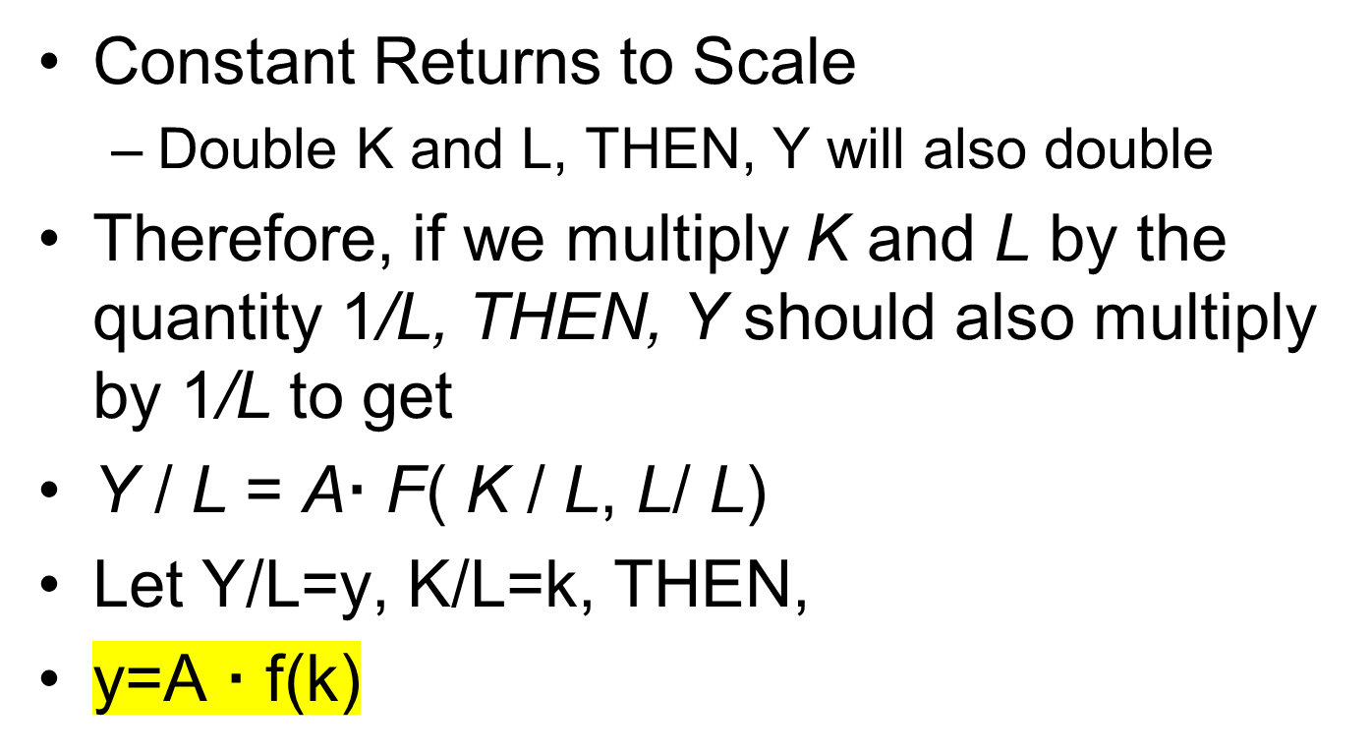
Constant Returns to Scale

Slide 18
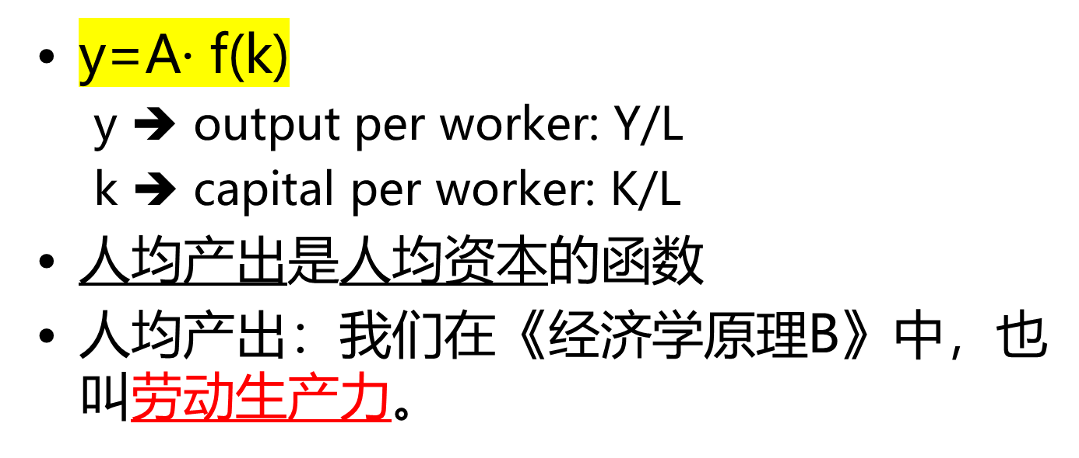
Per Worker Production Function

Slide 19
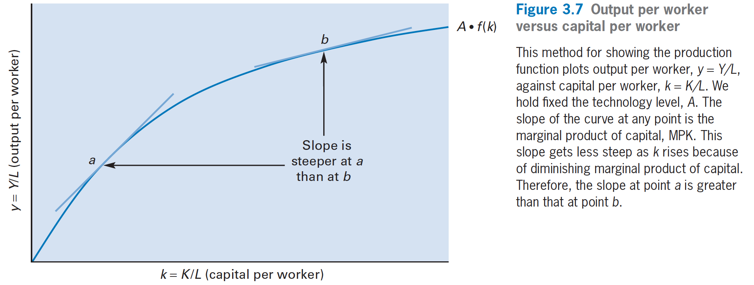
Per Worker Production Function

Slide 20
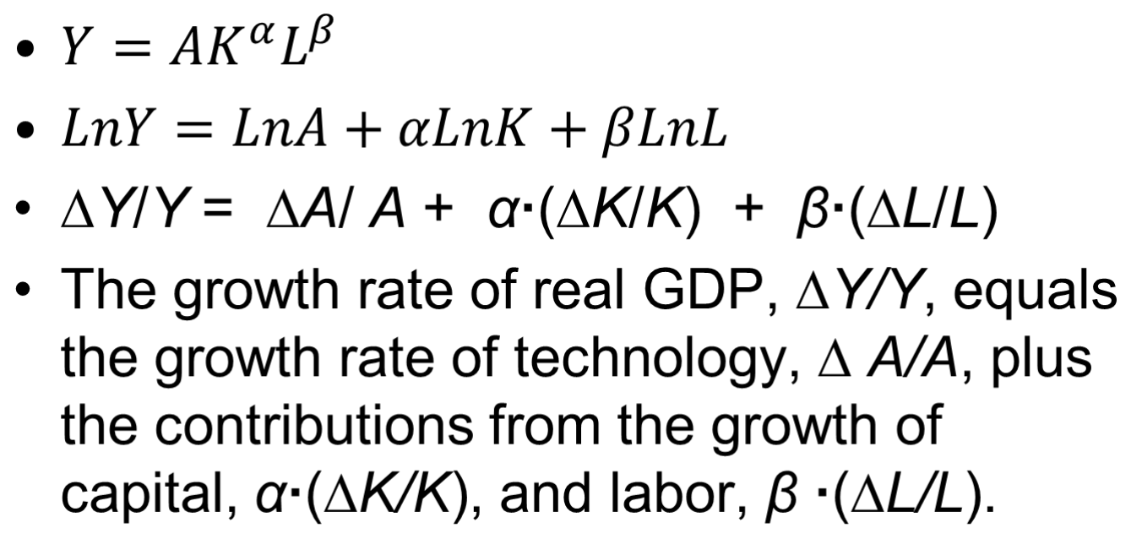
Contributions to GDP Growth
：柯布道格拉斯生产函数
比如 α=0.3，β=0.7

Slide 21
Contributions to GDP Growth
∆Y/Y = ∆A/A + α·(∆K/K) + β·(∆L/L)
  0 < α < 1，0 < β < 1
  可以推算技术进步的速度：g=∆A/A
α + β = 1，即 share of capital income (α) + share of labor income (β) = 1，比如 α=0.3，β=0.7
  α＋β＝1, 规模报酬不变，就是产量增加的比例等于生产要素的投入增加的比例。比如生产要素均增加10%，则产量增加10%。
  α＋β>1, 规模报酬递增，就是产量增加的比例大于生产要素的投入增加的比例
  α＋β<1, 规模报酬递减,就是产量增加的比例小于生产要素的投入增加的比例

Slide 22

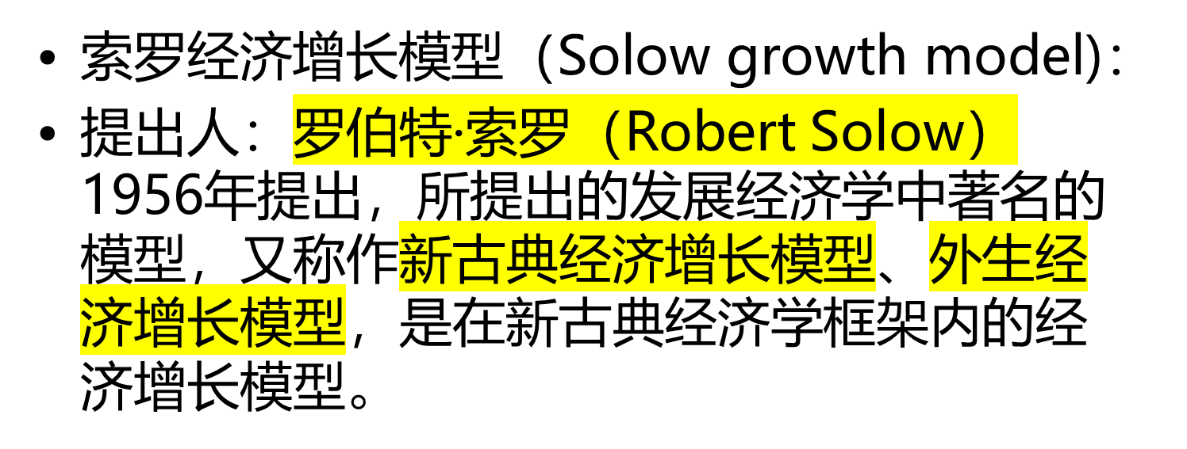

Slide 23
Solow Growth Model
Labor force, L
L= labor force participation rate · population
= (labor force/ population) · population
  Assume labor force participation rate is constant.
  因此，Labor force growth rate is the population growth rate, n.

Slide 24
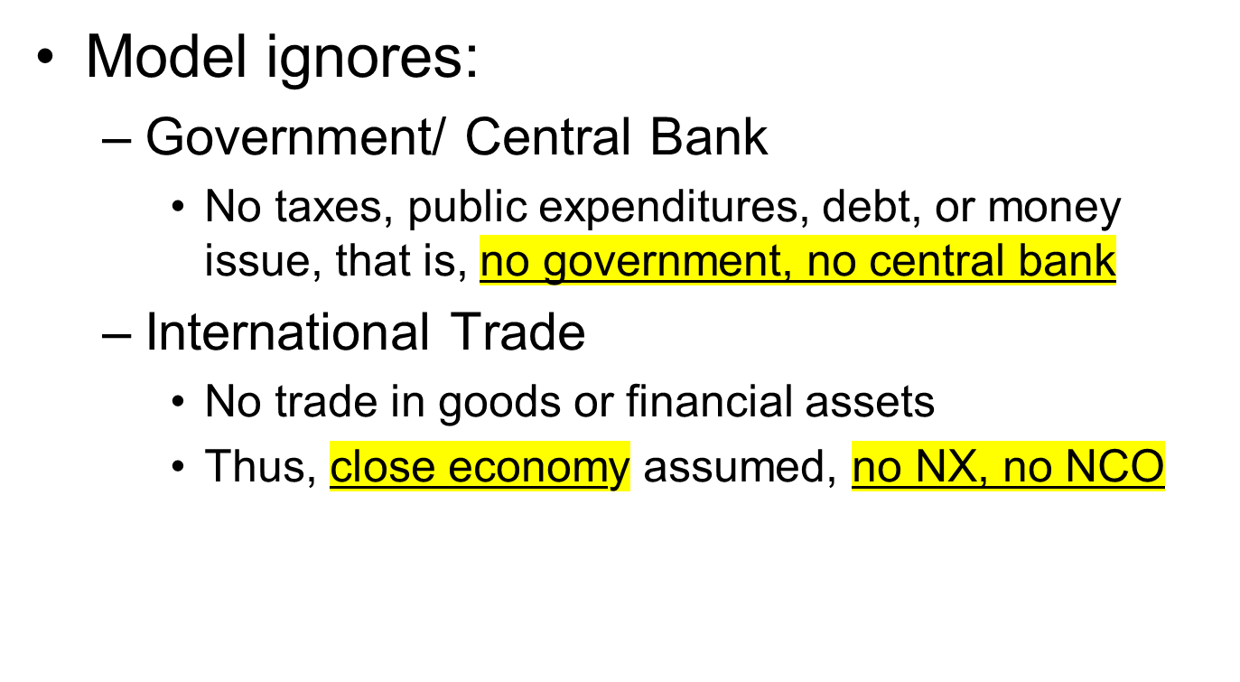
Solow Growth Model

Slide 25
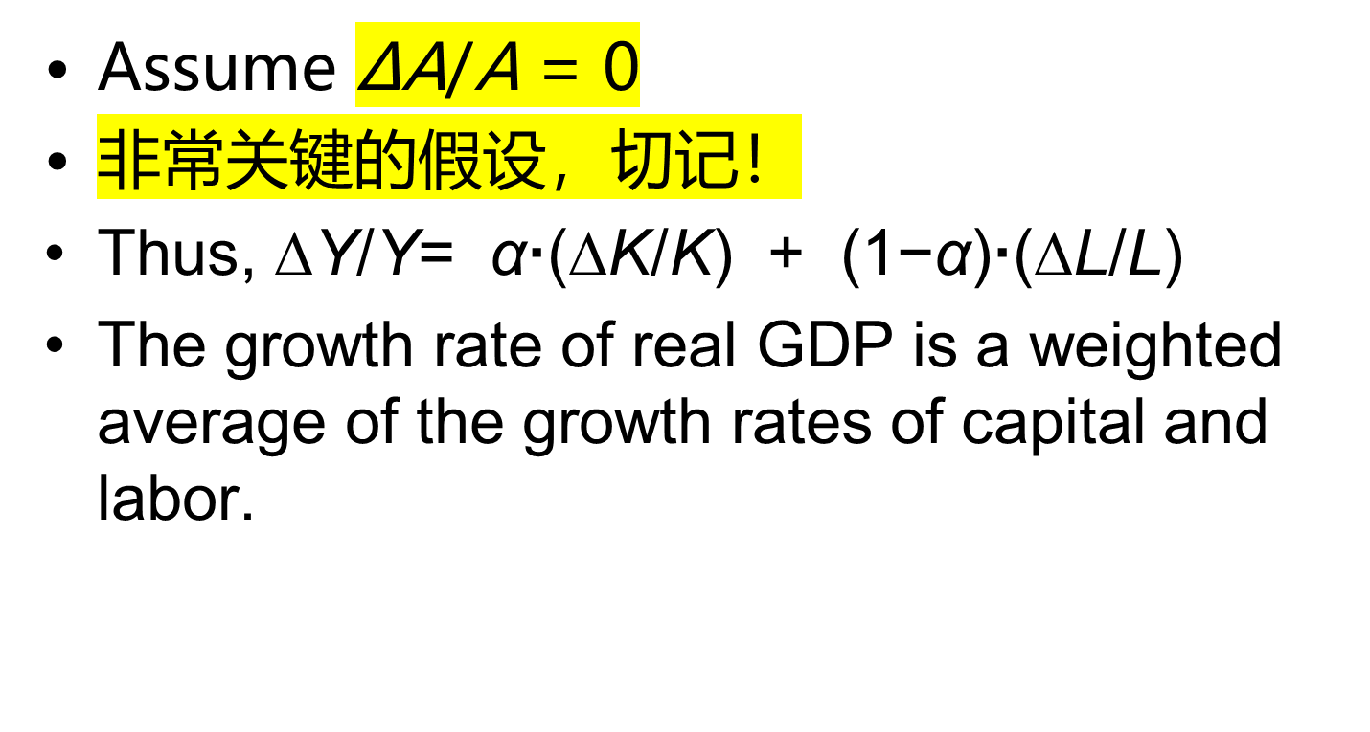
Solow Growth Model

Slide 26
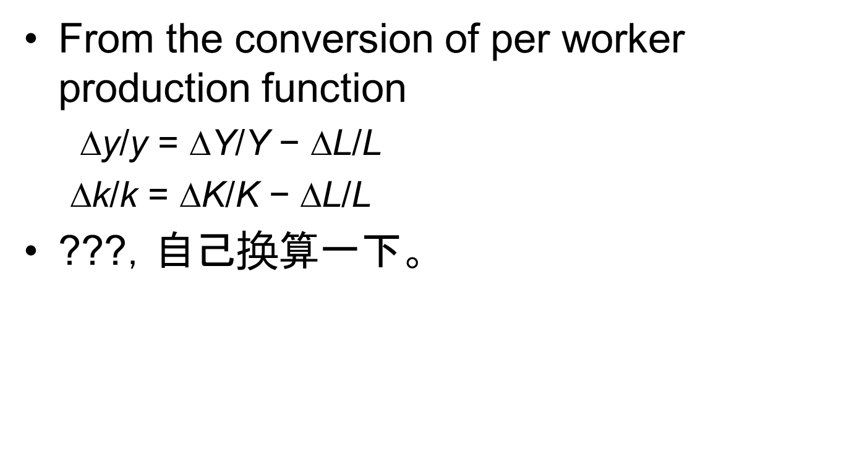

Solow Growth Model

Slide 27
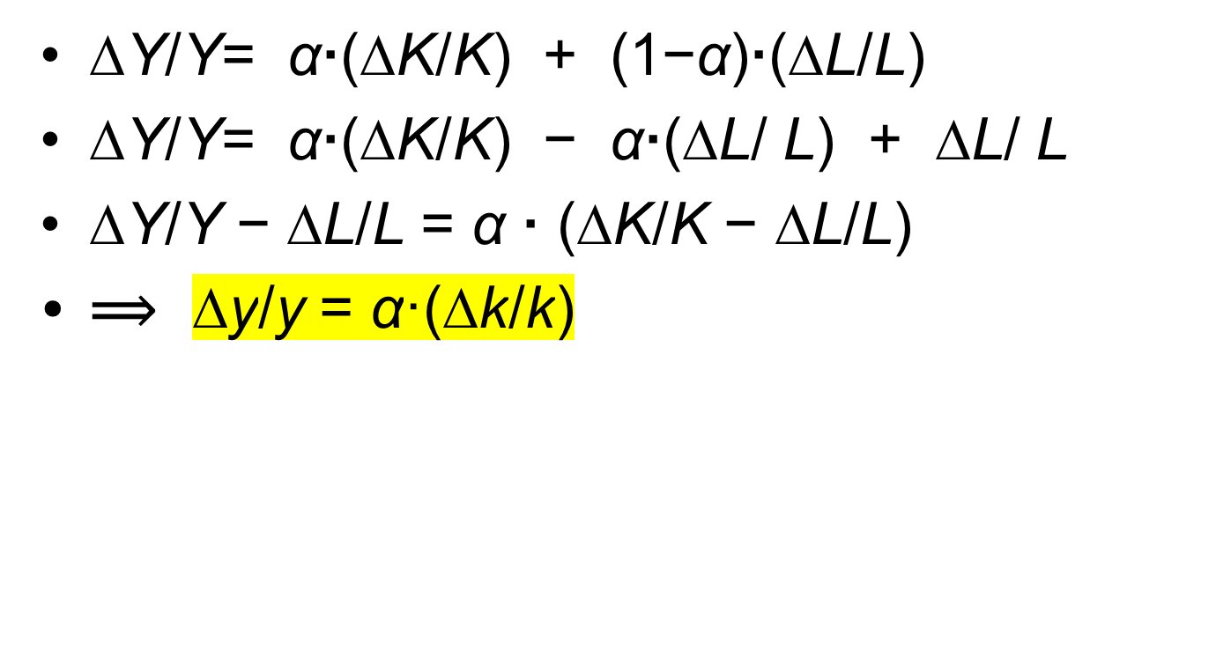
Solow Growth Model

Slide 28
Solow Growth Model
Each household divides up its real income in a fixed proportion s to saving and 1 − s to consumption ( C ).
Capital depreciate at the same constant rate δ
δK is the amount of capital depreciation each year
Y- δK: real net income

Slide 29
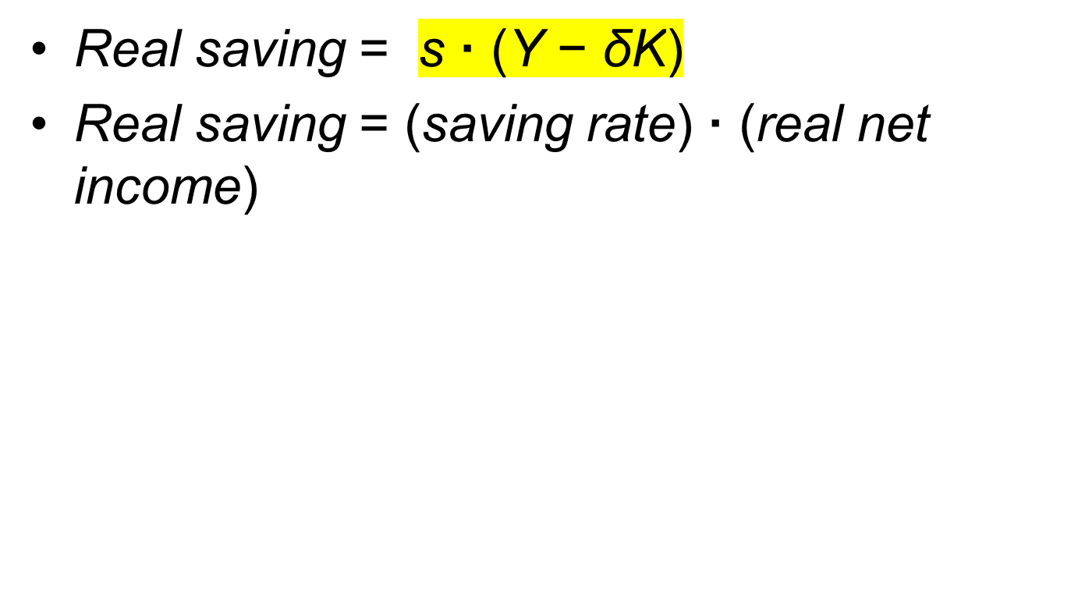
Solow Growth Model

Slide 30
Solow Growth Model
Y− δ K = C + S
Y− δ K = (1-s) · ( Y− δ K) + s · ( Y− δ K)
Real net income = consumption + real saving

Slide 31
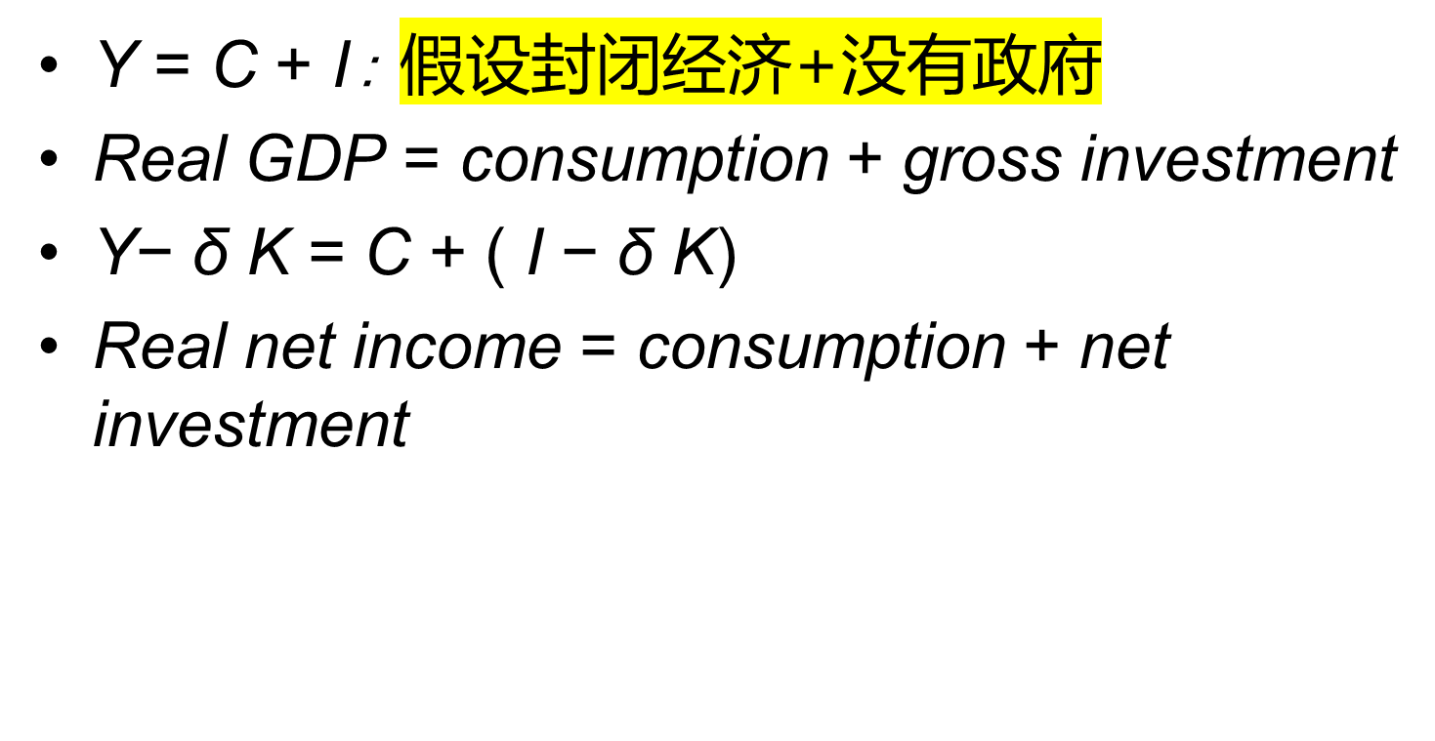
Solow Growth Model

Slide 32
Solow Growth Model
C+ s· ( Y− δ K) = C+ I − δ K
or
s· ( Y− δ K) = I − δ K
Real saving = net investment

Slide 33
Solow Growth Model
∆K = I − δ K
Change in capital stock = net investment
∆K = s· ( Y− δ K)
Change in capital stock = real saving

Slide 34

Solow Growth Model

Slide 35
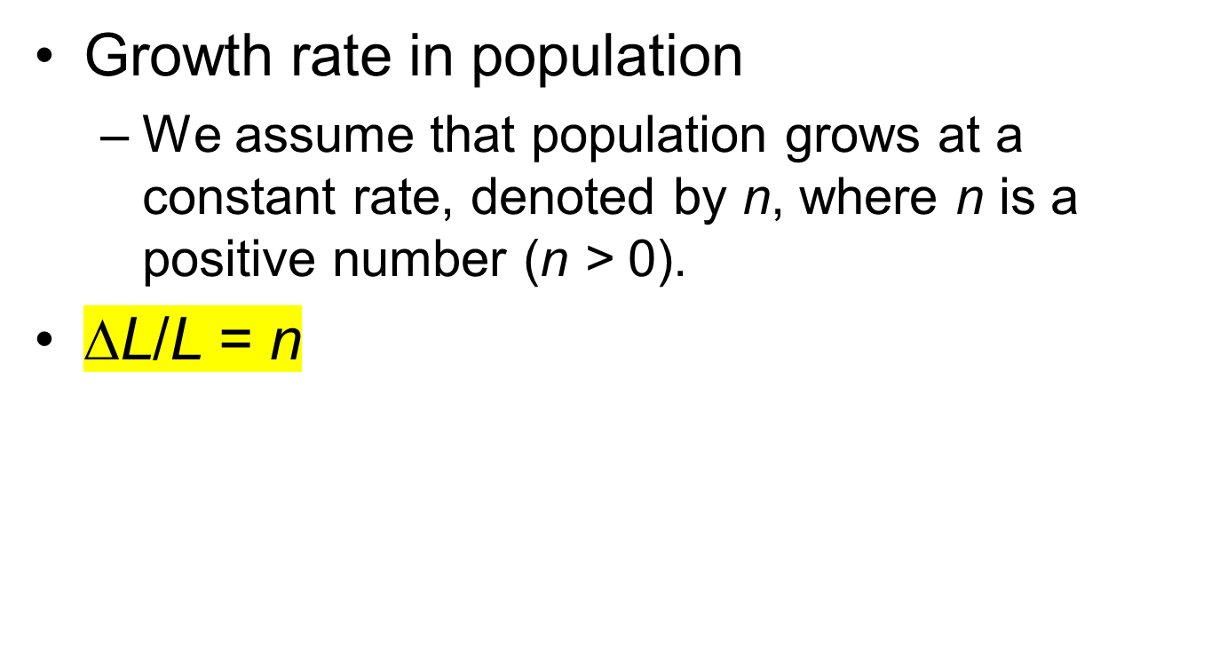
Solow Growth Model

Slide 36
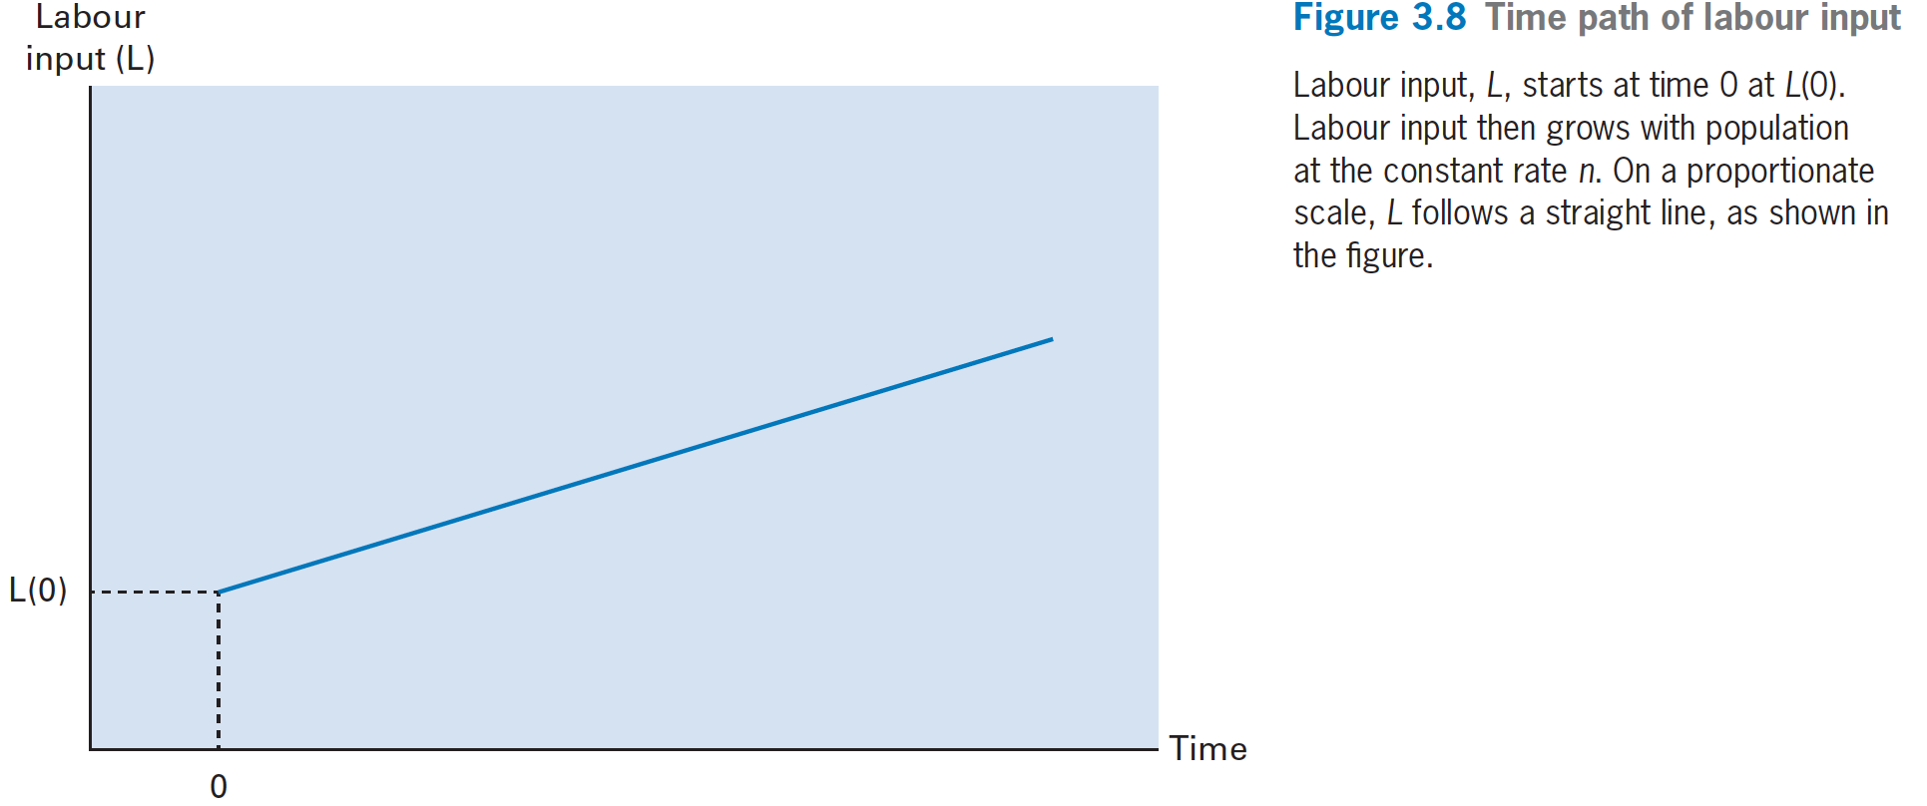
Solow Growth Model

Slide 37
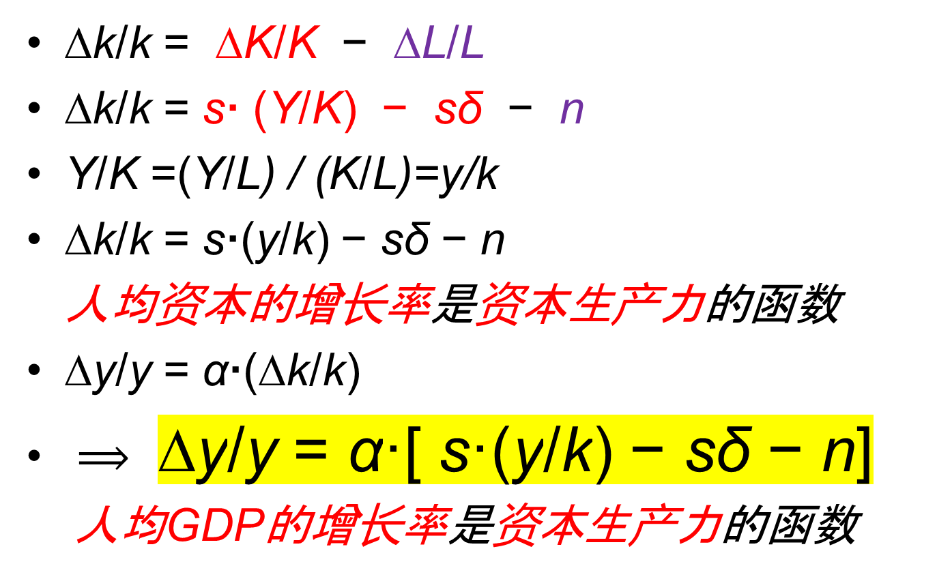
Solow Growth Model

Slide 38
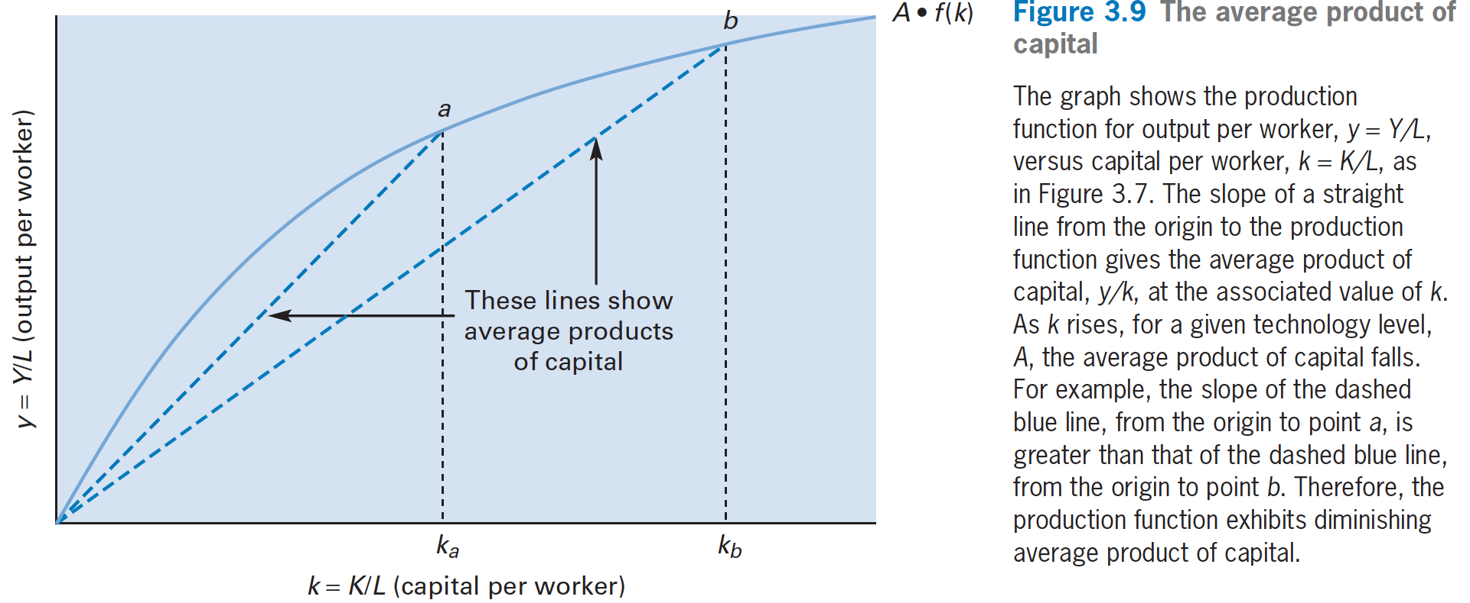
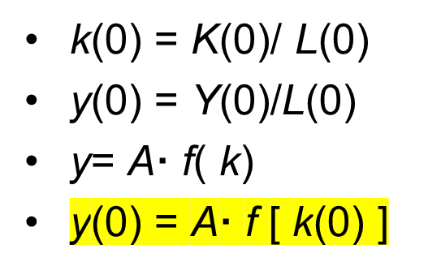
Solow Growth Model

Slide 39
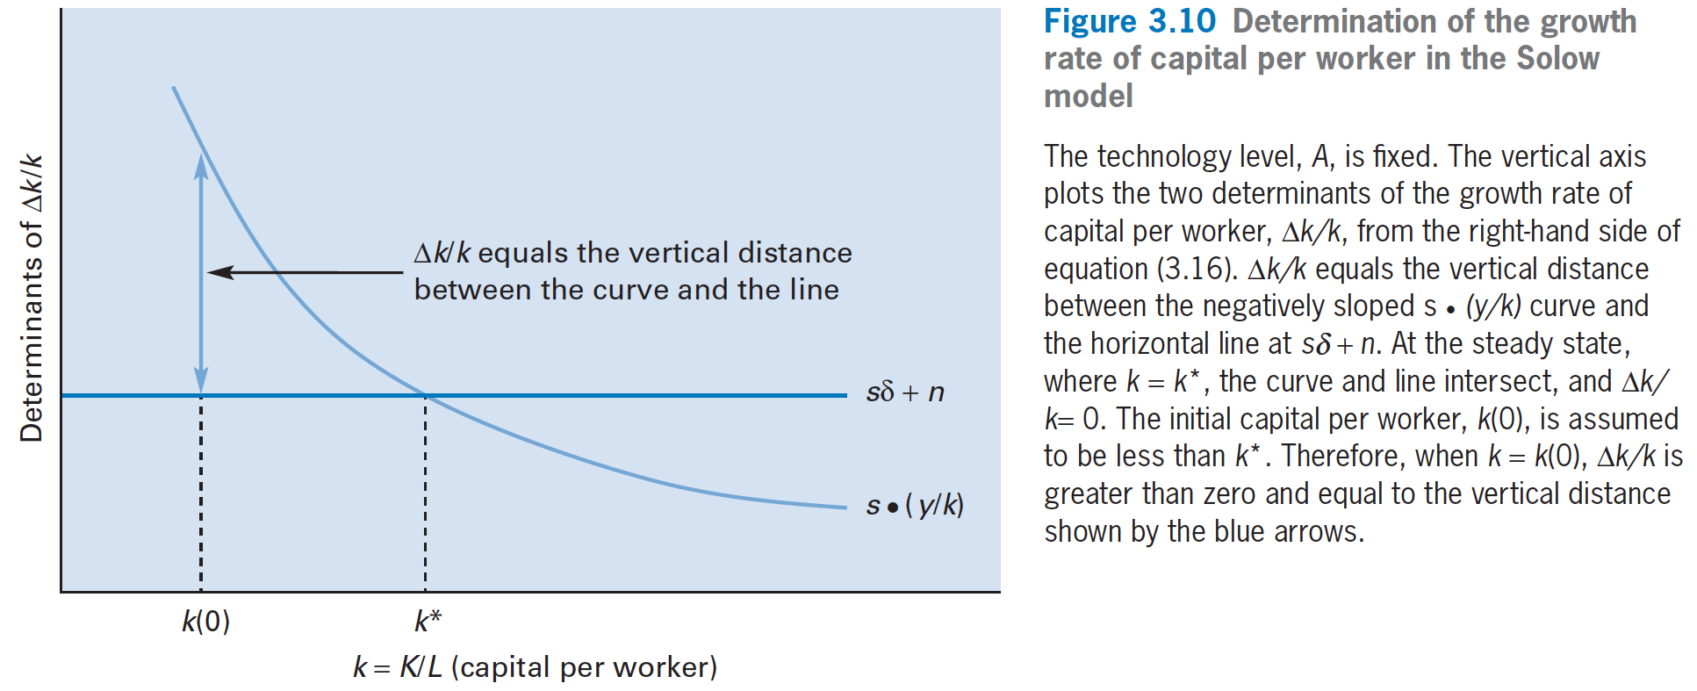

Solow Growth Model

Slide 40
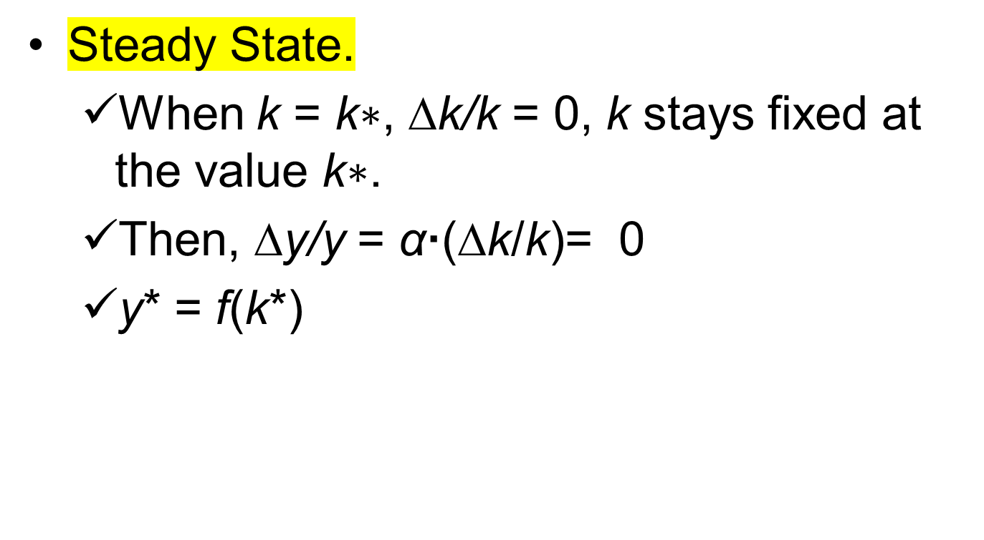
Solow Growth Model

Slide 41
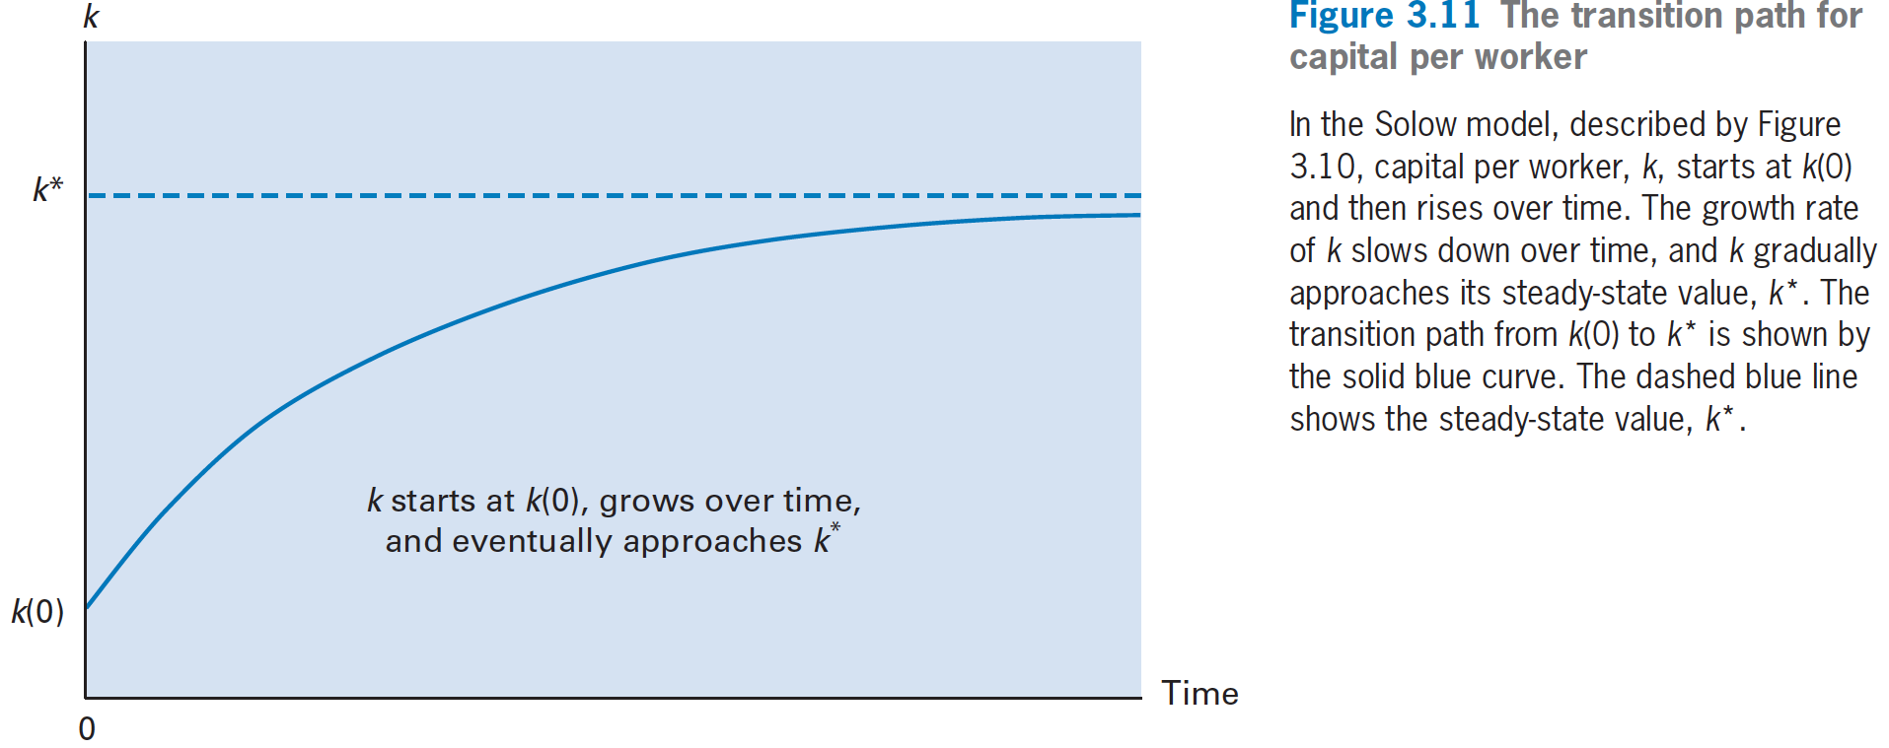
Solow Growth Model

Slide 42
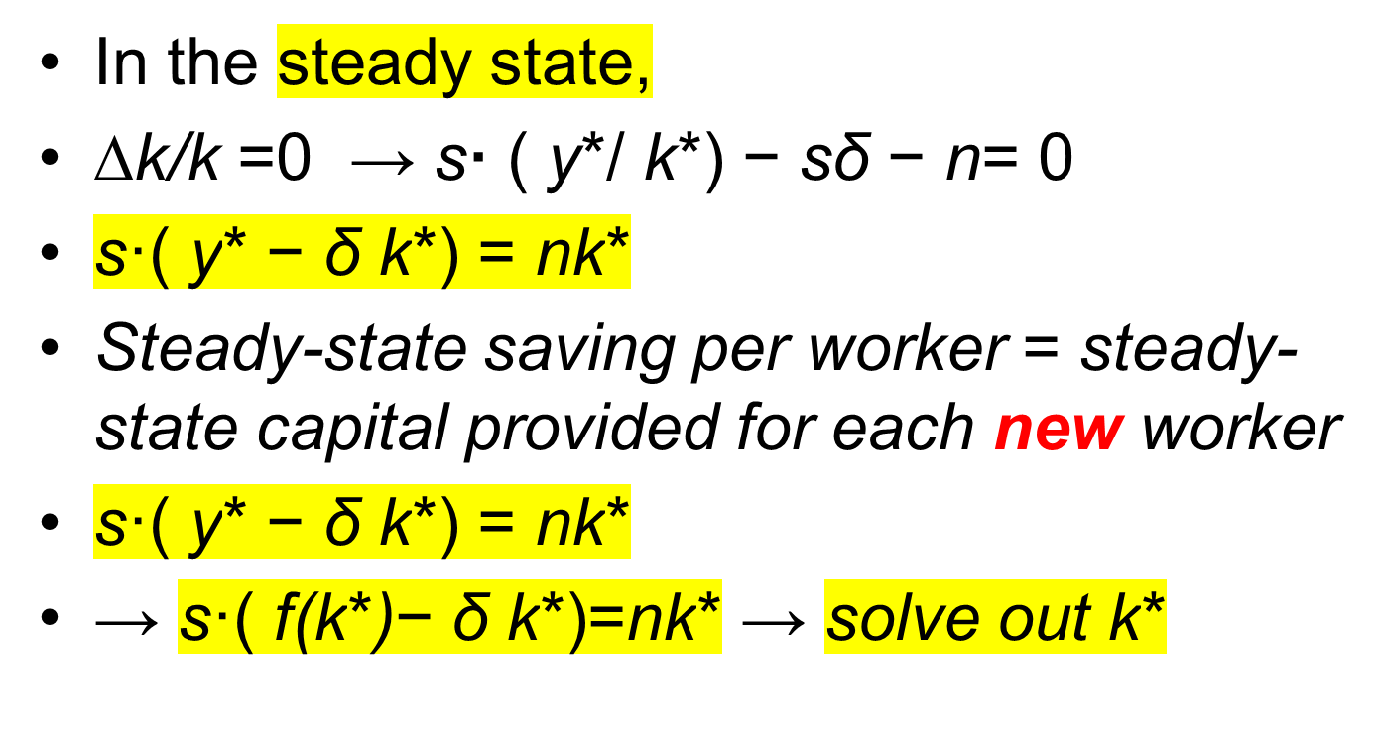
Solow Growth Model

